Slide 1


HIGH PERFORMANCE COMPUTING PYTHON LAB
2020
PARALLEL 3D CONWAY'S GAME OF LIFE
DONE BY: KODIRJON AKHMEDOV

Slide 2
Importance of Cellular Automata
Cellular automata can be used to simulate brain tumour growth by generating a 3-­dimensional map of the brain and advancing cellular growth over time
Can be used to model a wide variety of complex biological and physical systems for example, turbulence in fluids or Gas behavior, Urban development, Immunology and biological ageing
In ecology, cellular automata can be used to model the interactions of species competing for environmental resources
To create an artificial form of life—on a computer. to determine how complex systems, such as life forms, can emerge in a universe

Slide 3


Idea behind "life"
What is Conway's game of life?
What is the motivation?
What are rules?
One of the most significant and important examples of the cellular automaton is Conway's Game of life who was a British mathematician devised the term in 1970
Conway wanted to design his automaton such that emergent behavior would occur, in which patterns that are created initially grow and evolve into other, usually unexpected, patterns.
Each square cell can be live or dead . There are four simple rules underpopulation, overpopulation, reproduction, next generation

Slide 4

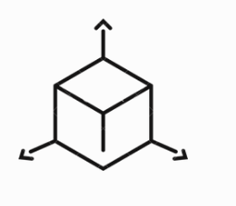
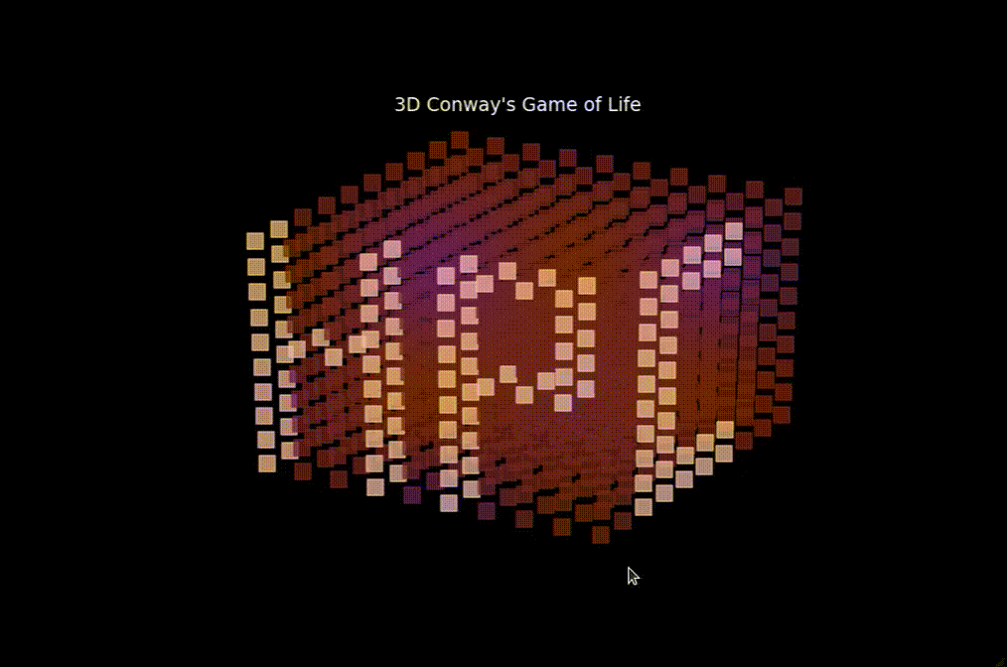

3D Conway's
Game of Life
Dimension
In a M-dimensional Life a point has 3M - 1 neighbors
Benefits of rules
in 3D we can get richer rules and structures.
Parallelization
For fast speed up the method can be parallelized such as MPI, OpenMP
Gaming industry
For example, MineCraft game has used inside the game
PS: Red- Dead cells, Gold-Live cells

Slide 5
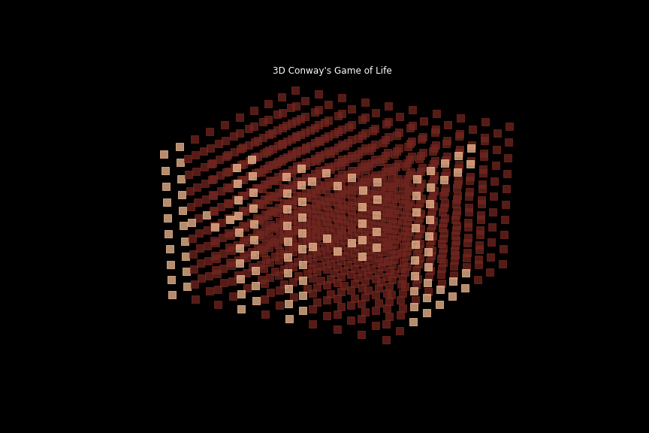
LET'S SEE OUR RULES AND RESULTS
RULE 1 (Floor by Floor)
Dead -> Live, when LiveNeigh>=3
Live -> Dead, when: LiveNeigh<=3
Live->Dead, when: LiveNeigh>=24
Number of iterations = 20. Gif duration=0.4 sec per iteration

Slide 6
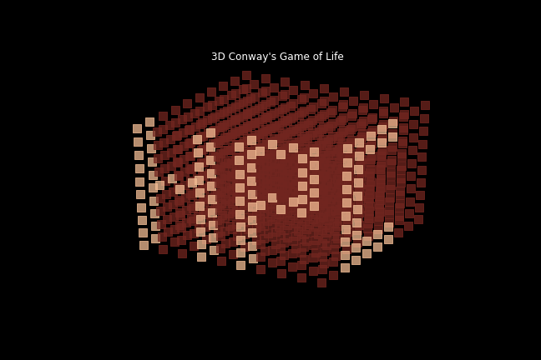
LET'S SEE OUR RULES AND RESULTS
RULE 2(Most Come Life)
Dead -> Life, when: LiveNeigh>=1
Live-> Dead, when: LiveNeigh<=4
Live -> Dead, when: LiveNeigh>=23
Number of iterations = 20. Gif duration=0.4 sec per iteration

Slide 7
LET'S SEE OUR RULES AND RESULTS
RULE 3 (All Go Dead)
Dead -> Live, when: LiveNeigh>=5
Live-> Dead, when: LiveNeigh<=2
Live -> Dead, when: LiveNeigh>=20
Number of iterations = 20. Gif duration=0.4 sec per iteration

Slide 8



PARALLELIZATION OF "LIFE"
PARALLEL METHOD
WE CAN ACHIEVE SPEEDUP AND LESS COMPLEXITY
- Using useful methods to change our serial codes into parallel
- We used Distributed Memory communication environment which is MPI
- With the help of Message Passing Interface we have can try many processors and check the working time

Slide 9
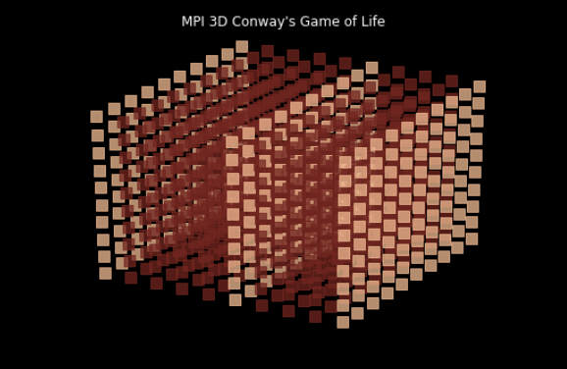
How do we parallelize ?
Giving the job to processors
Dividing into blocks
Gathering using comm.gather()

Slide 10
Results
Let’s switch to implementation
Click here to view implementation

Slide 11
THANK YOU

